Slide 1
SALARY PREDICTION FOR ENGINEERING GRADUATES
Final Presentation
Presented By:-
Group No. 6
PGP DSE June 2020
Gurugram
Project Mentor:-
Mr Shashank Shirude

Slide 2
Table Of Contents
Introduction
Problem Statement
Dataset Description
Exploratory Data Analysis
Feature Engineering
Clustering
Model Assumptions and Base Model
Model evaluation and insights
Business insights
Summary table

Slide 3
1.Introduction
AMCAT or Aspiring Minds Computer Adaptive Test evaluates candidates on the basis of their core skills which includes reasoning skills, quantitative aptitude, English and technical skills. The technical module is different for each candidate and depends on the course or the subject they opt for. It is a standardized test of job skills. The test includes cognitive, domain and personality assessments.

Slide 4
2.Problem Statement
Given a new student profile, can we predict whether he will get a good salary package or average one using his historic data.
Can we understand what factors in the labor market determine one’s salary? Is it just one’s skills or there are other factors which influence the return in the labor market? What signals and biases enter the labor market?

Slide 5
3.Dataset Description
The entire data is collected from Aspiring Minds' Employment Outcomes 2015. The dataset contains various information about a set of engineering candidates and their employment outcomes. For every candidate, the data contains both the profile information along with their employment outcome information. Candidate Profile Information includes:
Scores on Aspiring Minds’ AMCAT – a standardized test of job skills. The test includes cognitive, domain and personality assessments
Personal information like gender, date of birth, etc.
Pre-university information like high school grades, high school location
University information like GPA, college major, college reputation proxy.
Demographic information like location of college, candidates’ permanent location
Employment Outcome Information includes:
First job annual salary
First job title
First job location

Slide 6
Random AMCAT takers were surveyed via email wherein they provided information on the dependent variables in this dataset – the jobs they are in and their corresponding annual salaries. Corresponding independent information about the candidates was recorded at the time of them taking AMCAT.

Slide 7
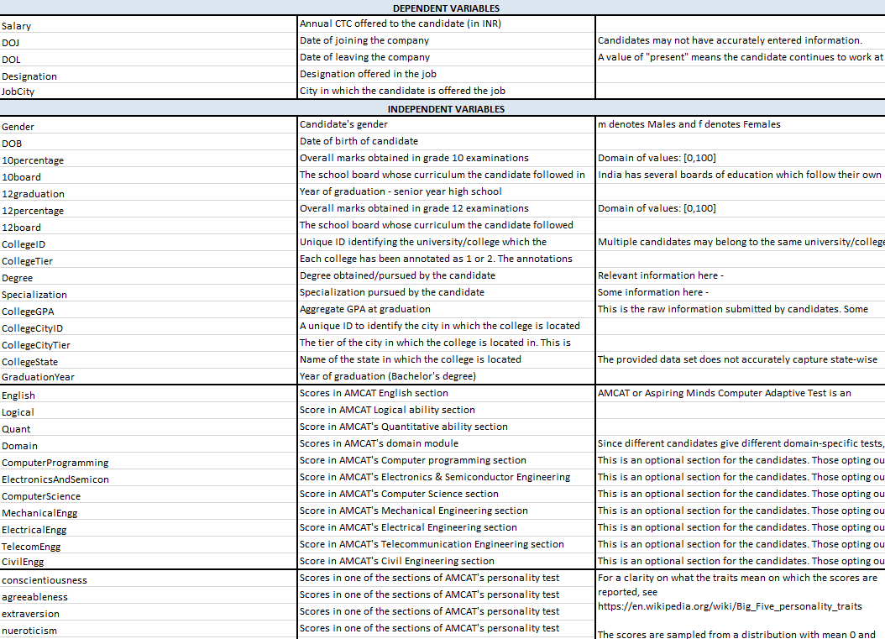
Dataset Description(Cont..)

Slide 8
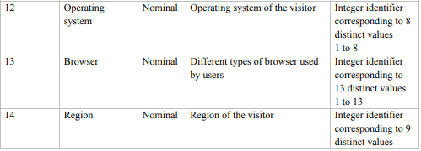
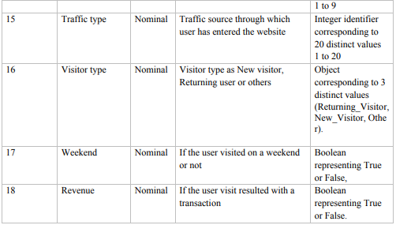
Dataset Description(Cont..)

Slide 9
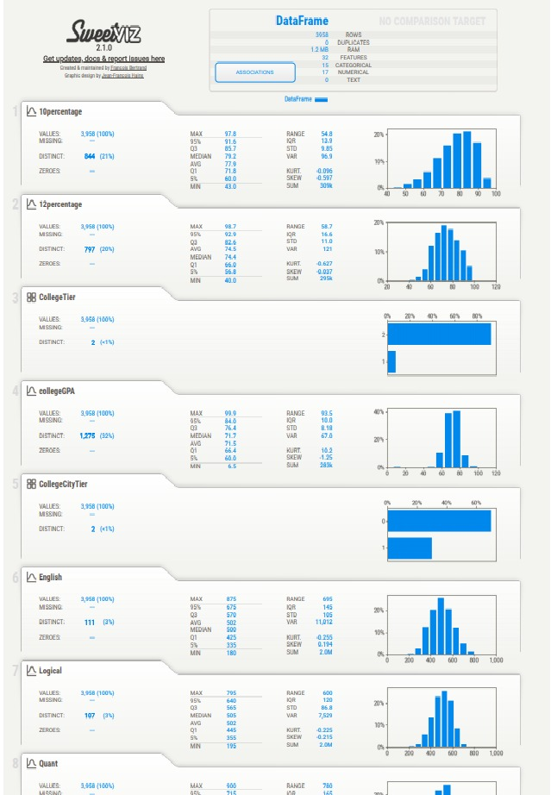
4.EXPLORATORY DATA ANALYSIS

Slide 10
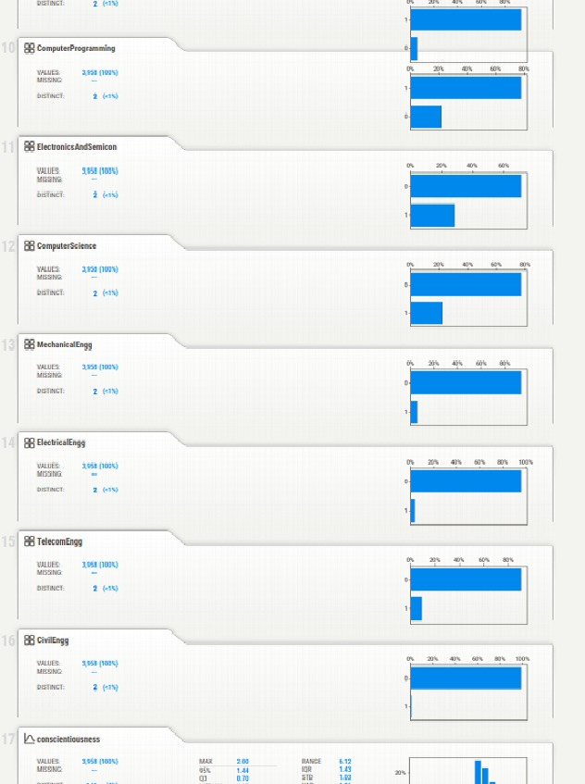

Slide 11
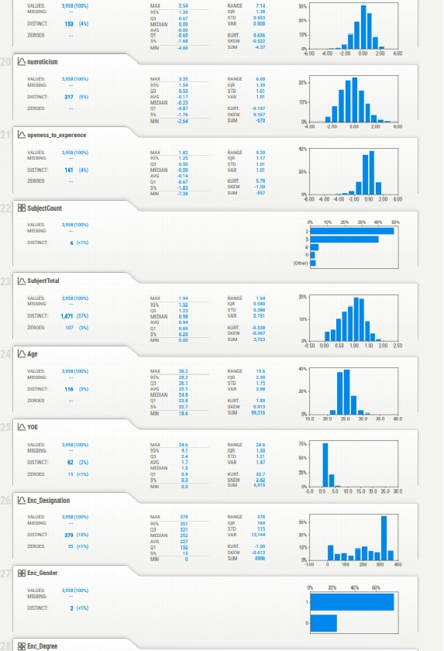

Slide 12
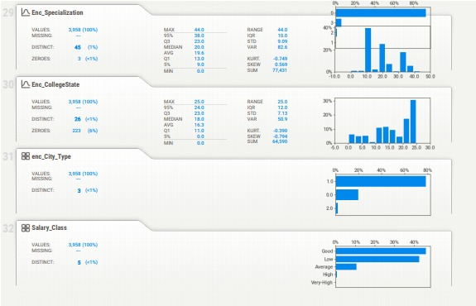

Slide 13
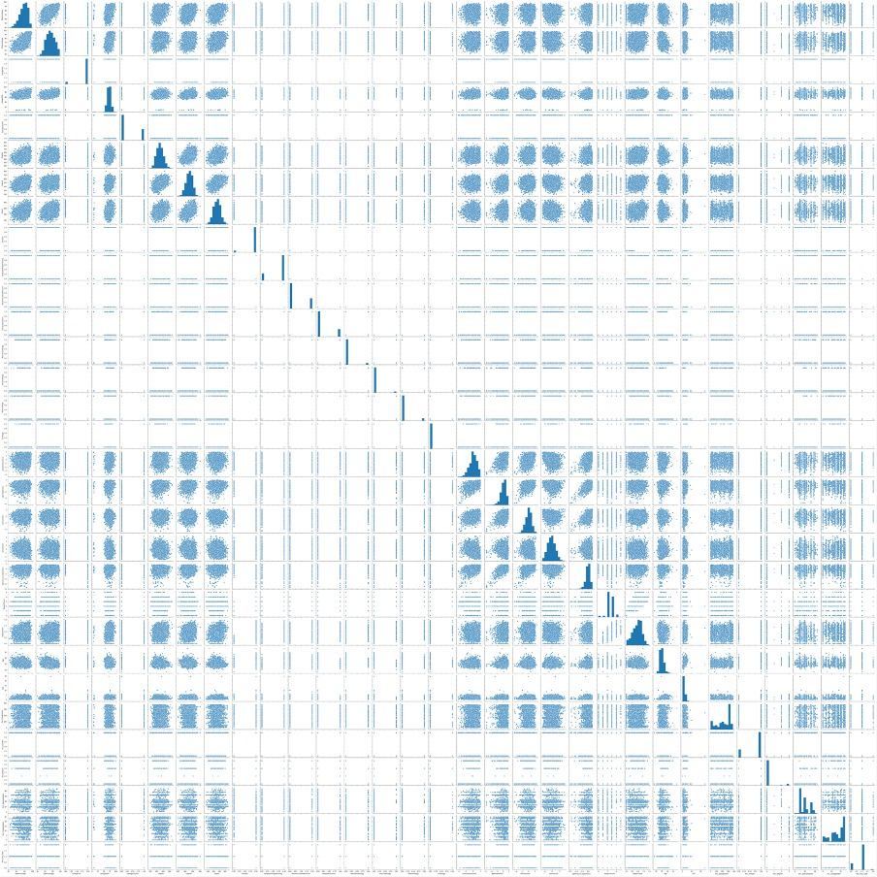

Slide 14
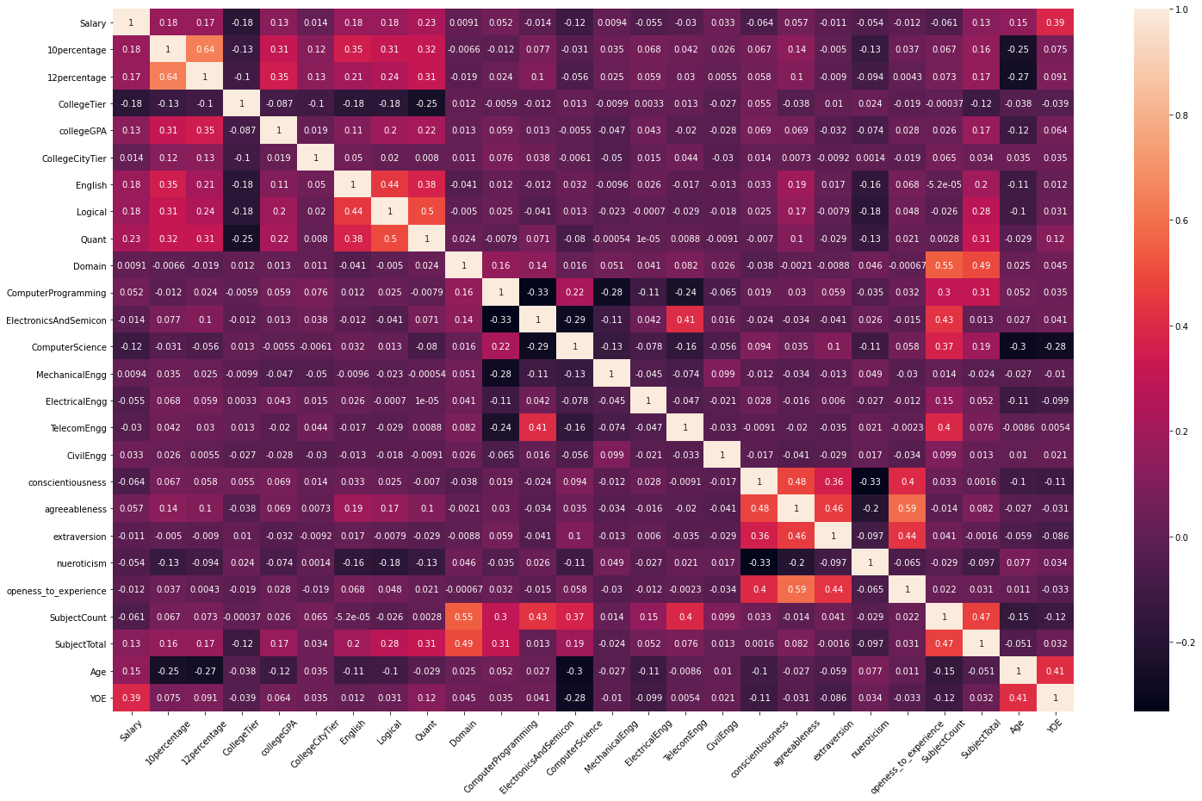

Slide 15

Count of graduates joined on specific year

Slide 16
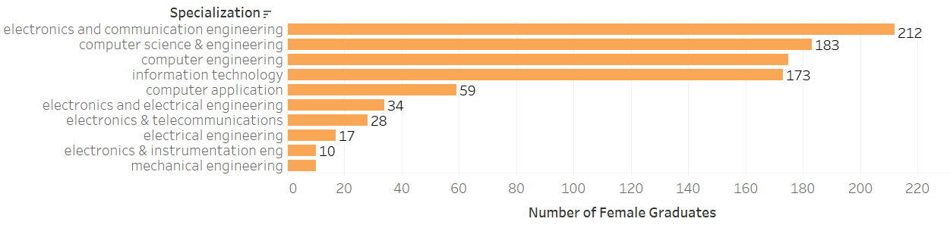
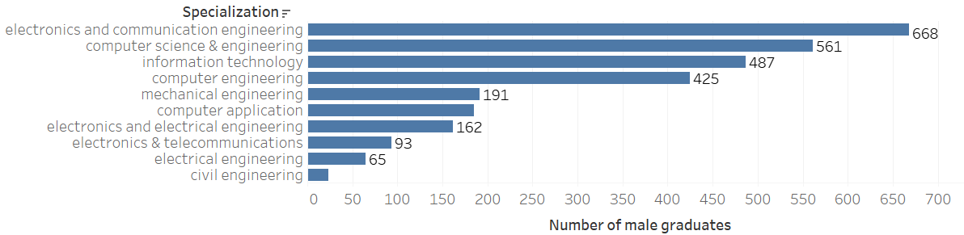
Gender wise distribution of salaries

Slide 17
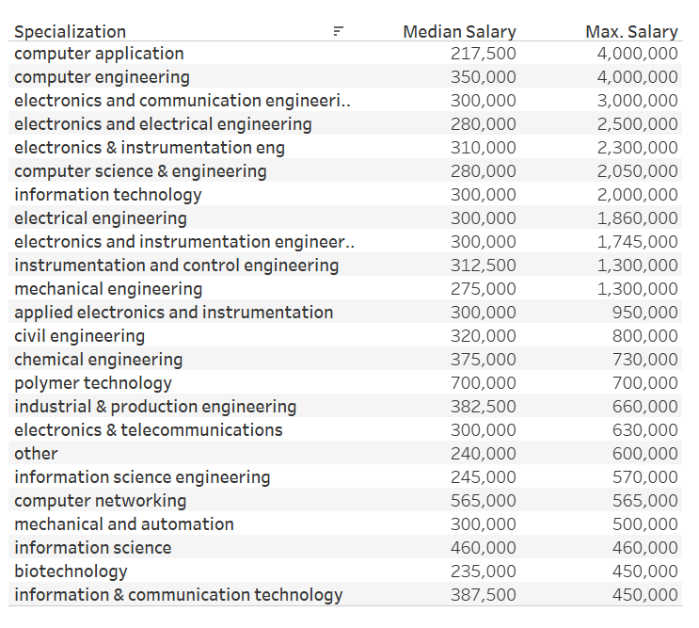

Slide 18
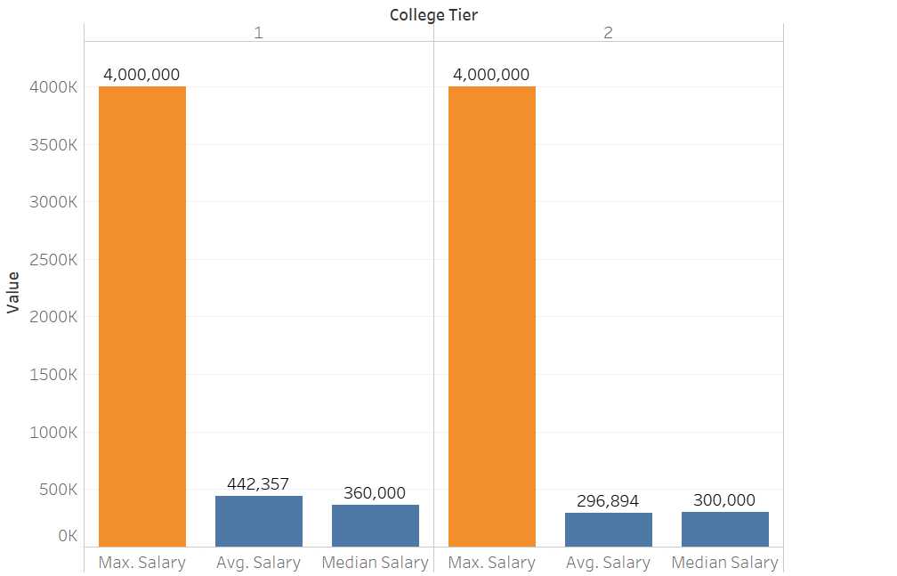
Effect of college tiers on salaries of graduates

Slide 19
Preprocessing:
1.One hot encoding for the categorical features proved to be very exhaustive as the features themselves had too many numbers of sub-categories. This resulted in the increase of dimensionality.
2.Other encoding methods can be tried out if there is a time availability constraint.
3.The numerical features were found out to have a skewed distribution and primary transformations were applied to bring it into Gaussian distribution.
4.Advanced transformation techniques can be experimented to treat the extreme values.

Slide 20
Modeling:
1.Most of the classification algorithms resulted in models with a commendable ROC_AUC score.
2.Hyper-parameters can be tuned if the improvement of f1-score is the intention.
3.Neural Networks and other deep learning techniques can be used to build models which offer better generalization even though our models had a very considerate variance error.

Slide 21
9.2 Commercial /Research Value:
Commercial:
1.This study can be used to predict the intention of the online shopper. Our best models can be used for the same.
2.PageValues have proved to be the most crucial feature for predicting the intention.
3.BounceRates have been proved to be inversely proportional to the revenue generation. As a result, pages with high Bounce Rates could be managed better for better revenues.
4.Month of November was found to have the highest revenue generation, which in turn would indicate the surge of customers. Attractive offers can be put up to attract more customers.

Slide 22
Research Value:
1.There is further cope for research with respect to the clustering techniques. As this dataset contained high number of categorical features, k-modes was applied.
2. Other clustering techniques can be applied to finding out hidden patterns. This way, it could help in clusters with better similarity and certain products can be advertised to a specific cluster of shoppers.

Slide 23
9.3 RECOMMENDATIONS BASED ON INSIGHTS
XGBoost model without hyper-parameter tuning with a dataset balanced using SMOTE is the best method to predict the online shopper’s intention.
This conclusion was reached after comparing six different machine learning models on a dataset of standardized, one-hot and label encoded variables.
The XGBoost classifier not only performed well in accuracy wise, with an accuracy of 93%, precision of 93% and recall of 93% and AUC Score of 98%, but also adjusted well to changes in dataset (low variance error) and took a far lower time to execute compared to more complex algorithms that performed the same.

Slide 24
Regarding the studies related to Data Science studies, it is to be made clear that this study can be used only for prediction purposes and decision making despite good mathematical results.
Despite the impressive results, shopper’s behaviors and also the trend of the market may be subjected to changes in the upcoming days.
The important features can be used as a preliminary indicator of the intention of the shopper. The least important factors can be neglected during this process.
Coming to the second objective, XGBoost model without tuning can be used for the same. Other five models have also proved to be a challenger but can be used for experimentation

Slide 25
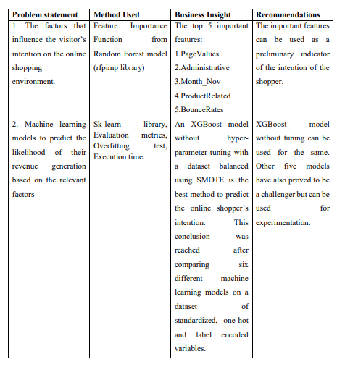
10. SUMMARY TABLE

Slide 26
Thank You

